Slide 1
Basic Electrical and Electronics Engineering
Dr. Sonam Shrivastava/ Assistant Professor (Sr.) /SELECT
LECTURE 1. 5

Slide 2
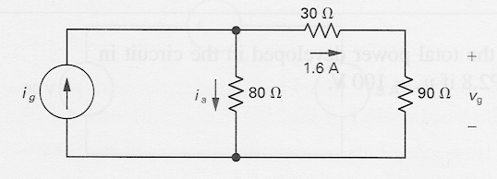
Example: Power Absorbed by a Resistor
p = vi = ( iR )i = i²R
p = vi = v ( v/R ) = v²/R
Example:
Calculate the voltage v_{g} and current i_{a}.
Determine the power dissipated in the 80Ω resistor

Slide 3



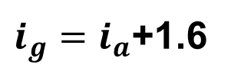
Example: Power Absorbed by a Resistor
$$V_{g}=1.6×90=144 V$$
$i_{g}=i_{a}$+1.6
$$−1.6×30−1.6×90+{80×i}_{a}=0$$
$$i_{a}=2.4 A$$
$$P_{80 ohms}=460.8$$

Slide 4
Source transformation
An electrical source transformation is a method for simplifying circuits by
Replacing a voltage source with its equivalent current source,
Replacing a current source with its equivalent voltage source.
Source transformations are implemented using Thévenin’s theorem and Norton’s theorem.

Slide 5
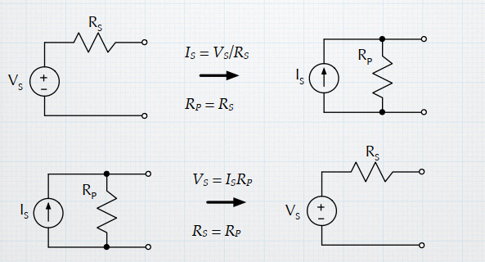
Source transformation

Slide 6
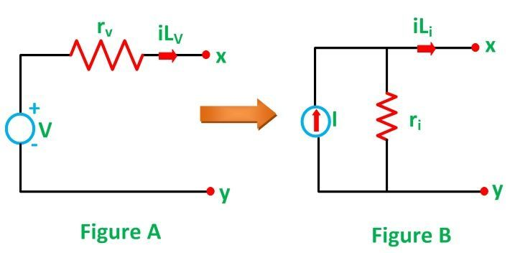
practical voltage source in series with the internal resistance r_{v},
represents a practical current source with parallel internal resistance r_{i}

Slide 7
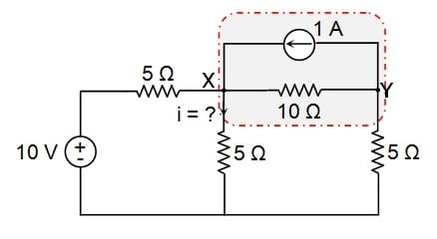
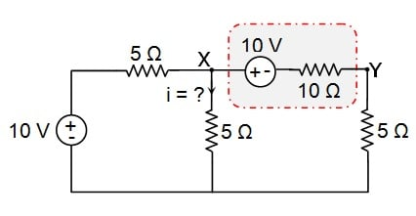
Example

Slide 8
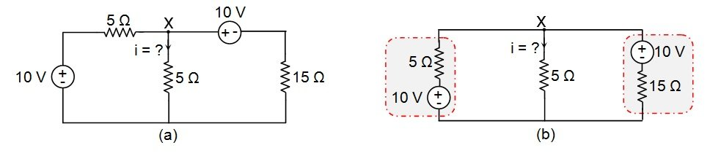
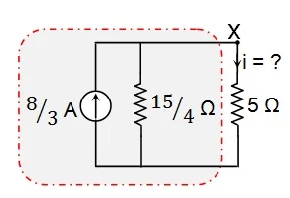
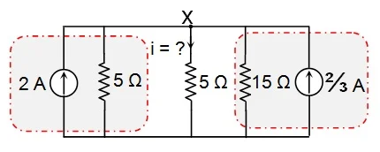

Slide 9
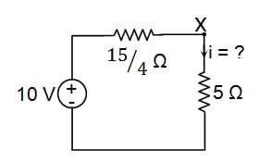
i=1.14 Amps

Slide 10
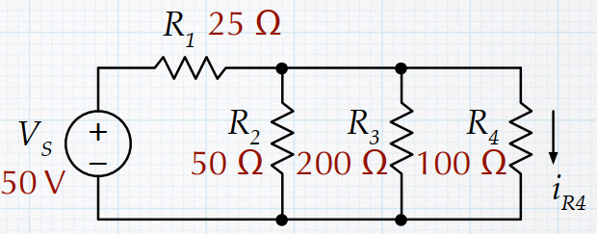

Question 1
Find $i_{R4}$ in the circuit at right.

Slide 11
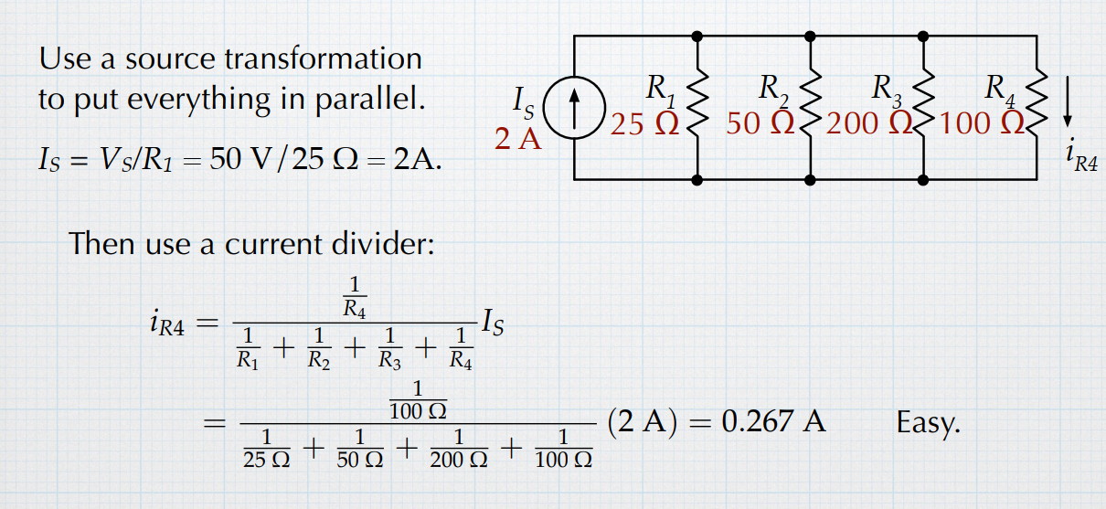

Solution 1
Apply current division to find $i_{R4}$
0.267 A

Slide 12
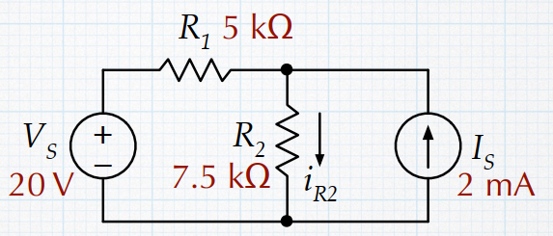

Question 2
Find $i_{R2}$ in the circuit at right.

Slide 13
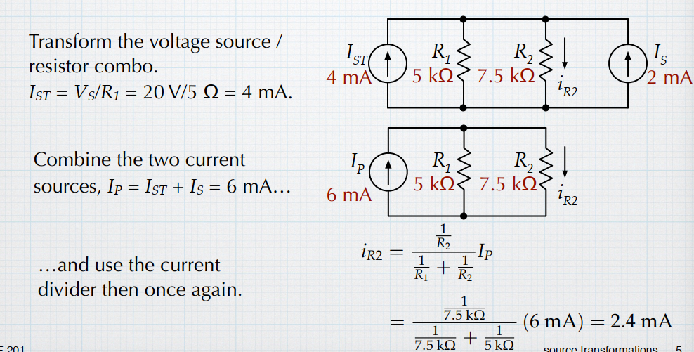
Solution 2

Slide 14
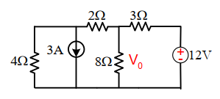
Question 3. For the circuit shown in Figure determine the V0 using source transformation.

Slide 15
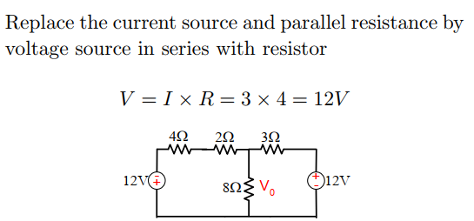
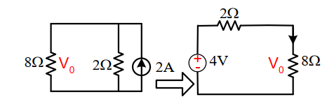
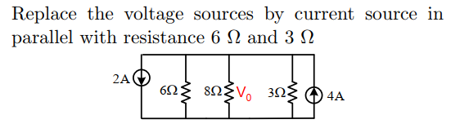
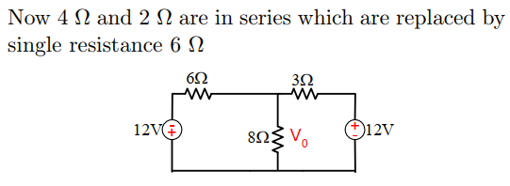

Slide 16
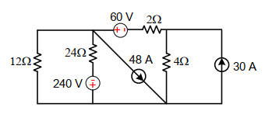
Question 4.
Determine the current in the 12 Ω resistor using source transformation method

Slide 17
Determine the current in the 12 Ω resistor using source transformation method
Answer= 8A

